Slide 1
Analyzing Processes
Chapter 9

Slide 2
NYPD Process for
Tire Replacement
Officer fills out Tire Replacement Request (TRR) form
Tire Integrity Unit reviews request
Officer picks up tire at a vehicle maintenance facility
City approved vendor replaces tire
Used tire returned to police garage
Precinct commander signs
Tire Integrity Unit compares original and signed forms
Estimated 1995 salaries for tire changing: $500,000

Slide 3
Los Angeles Police (1996)
At each change of shift, each officer spends 30 minutes signing in/out equipment
Each month each officer spends 3 hours requesting days off for the next month
Every arrest must be approved by the watch commander

Slide 4
Los Angeles Police (1996)
Arresting officers drive detainees to the precinct, wait for the watch commander to be available, then drive the detainees to booking. The arrest approval rate by the watch commander is over 99.8%
Arrest/booking forms for juvenile drunk driving require manually writing the suspect’s name 70 times

Slide 5
Productivity in the insurance industry, 1988-1991 average
Firm General expenses /premiums
Connecticut Mutual 20.5%
Phoenix Mutual 15.7%
Northwestern Mutual 6.9%
(source: HBR, July-Aug 1997, p.90)

Slide 6
Banking: 126 bank study (1996)
Opening a checking acct with a $500 cashier’s check and no prior banking relationship
Activity time Customer time
Best bank 27 minutes 24
average 54 42
worst bank 70 59
worst 20 banks >=60 >=48

Slide 7
Medical Systems
Nov 30, 1999 Wall Street Journal
“Medical errors may kill 44,000 to 98,000 patients a year”
Study: National Academy of Sciences Inst. of Medicine
Medical errors partly result in 180,000 patient deaths a year (1991 Harvard study)
Total cost of preventable mistakes: $29 B/yr.
225 wrong-site surgeries 1985-1995
¼ of orthopedic surgeons will operate on the wrong site in their career

Slide 8
Process Flow Charts:
Three Primary Soft Managerial Uses
Process Communication
  The process flow chart is the vehicle that communicates the process
Focusing managerial attention on the customer
  Laying out the process in the customer’s time frame refocuses efforts towards the customer
Determine what to work on and when to stop improving processes
  Flow charts identify bottlenecks and what is important to work on

Slide 9
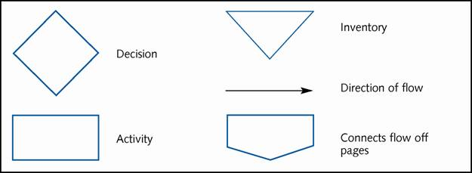
Analyzing and Improving Processes
Building a process flow diagram is the first step
  Arrows show the direction of flow
  Diamonds denote decisions
  Activities are represented by rectangles
  Delays are represented by inverted triangles

Slide 10
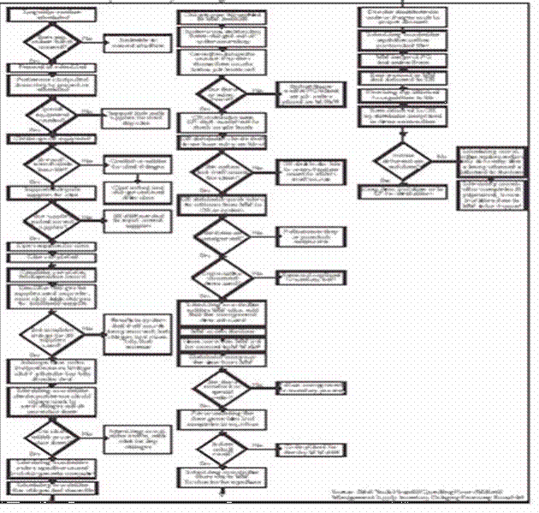
PROCESS FLOW CHART EXAMPLE:
Inventory ordering process for a hospital OR

Slide 11
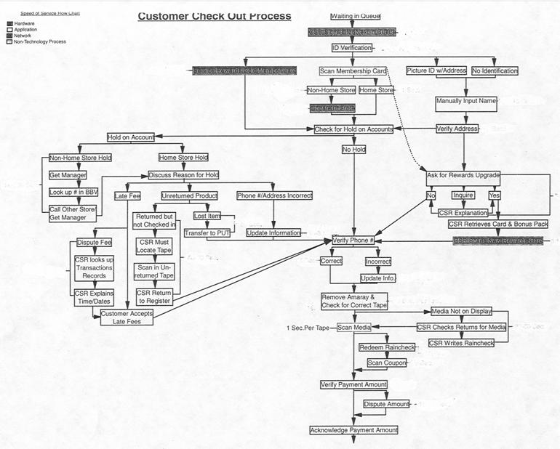
Blockbuster Video Check-out Process

Slide 12
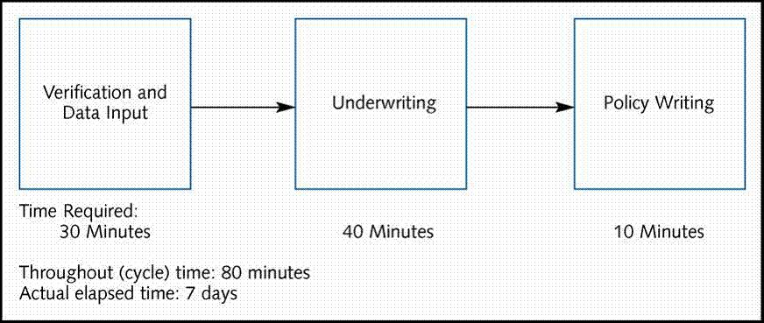
Idealized Back-Office Insurance Policy Process

Slide 13
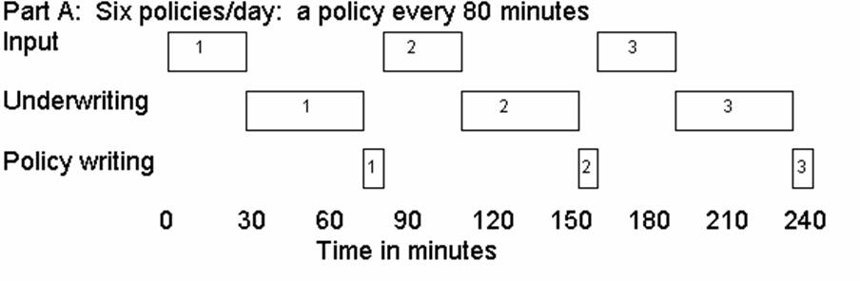
Gantt Chart of Insurance Process

Slide 14
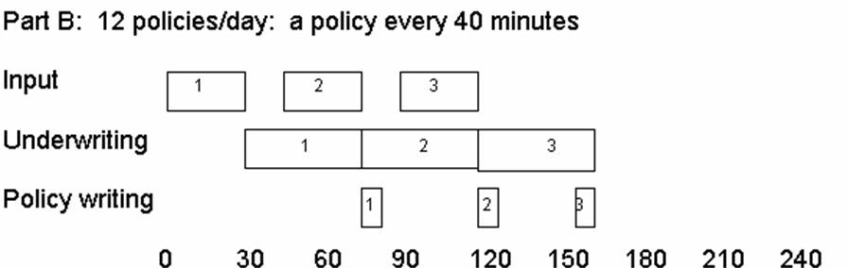
Gantt Chart of Insurance Process

Slide 15
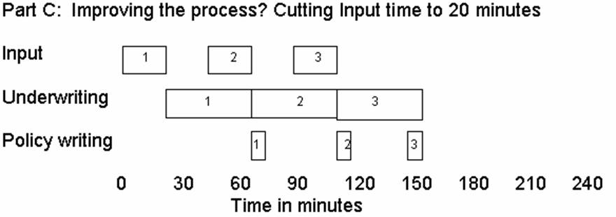
Gantt Chart of Insurance Process

Slide 16
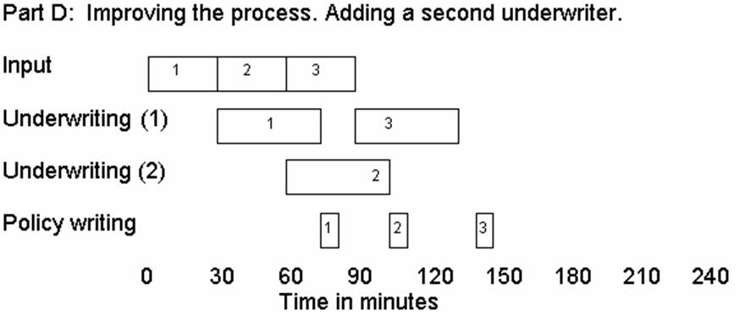
Gantt Chart of Insurance Process

Slide 17
Process Simulation
Allows designers to develop and perform experiments on a model of a real system
Leads to a better understanding of a real system and is more general than mathematical models
Allows compression of time
Can answer what-if questions and can be used to analyze transient conditions

Slide 18
Process Simulation
Five crucial steps
Planning Study
- Define problem
- Essential aspects
- Objectives
- Accuracy and realism
Model Run and
Validation
Define Service System
Variables
Parameters
- Rules
- Probability distributions
Analyze and
Report Results
Select Software and
Construct Model
Required statistics and reports
Data analysis alternatives
Animation or graphic display
User-friendliness

Slide 19
Process Simulation
Modeler must define the objective and constraints of the project
  Is there an existing system?
  What is the objective?
  What aspects of the process need to be included in the model?
Evaluate how one service process design performs compared to another

Slide 20
Defining the System
During this phase, the modeler…
  Determines the relevant variables
  Determines variable characteristics
  Determines system rules
  Collects data that emulate the input variables in the model

Slide 21
Defining the System
The first step is specify variables, parameters, rules and probability distributions
After obtaining all pertinent information, the appropriate software should be selected

Slide 22
Selecting Software and
Building the Model
Desirable features for software are the ability to…
  Generate standard statistics
  Allow a variety of data analysis alternatives
  Have animation capabilities
  Demonstrate user friendliness for both clients and consultants

Slide 23
Validating the Model and Running Experiments
Test the model to ensure that it accurately depicts the real system
Do the results appear reasonable?
Do the results indicate a discrepancy between the real system and model?
The experimental process involves running a number of scenarios
  Must run the simulation long enough to achieve steady-state

Slide 24
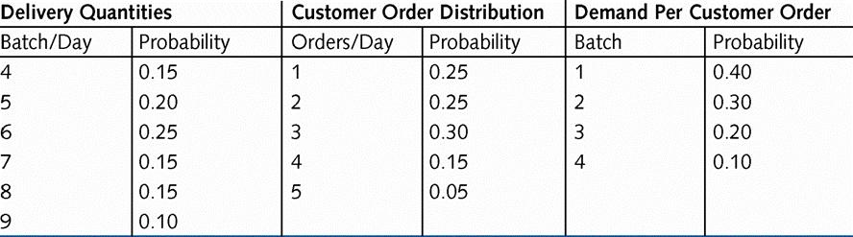
Manual Simulation
Empirical distribution for Albert’s Wholesale Bagels

Slide 25
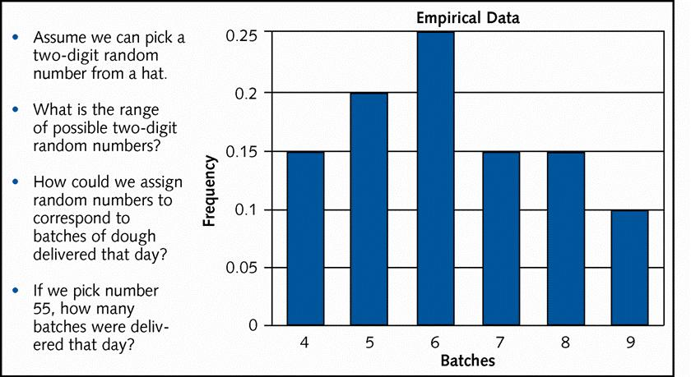
Using Random Numbers to
Simulate Delivery Quantities

Slide 26
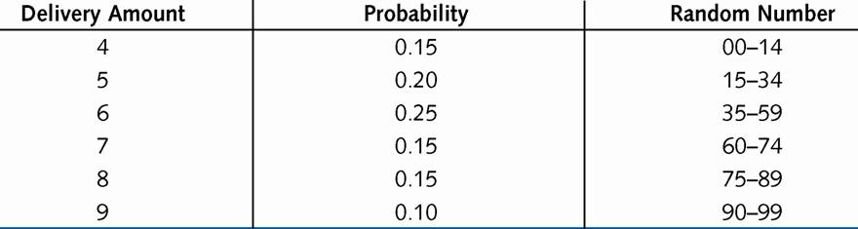
Random Numbers and
Batches Delivered

Slide 27
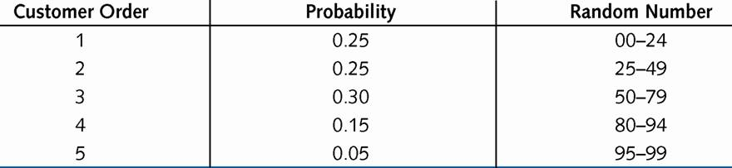
Random Numbers and
Customer Orders

Slide 28
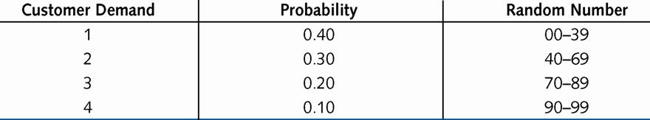
Random Numbers and
Customer Demand

Slide 29
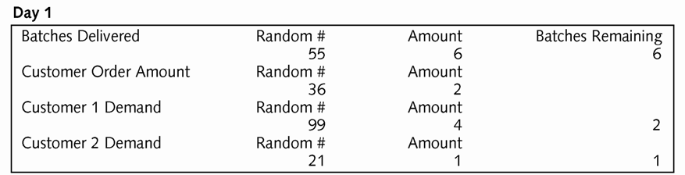
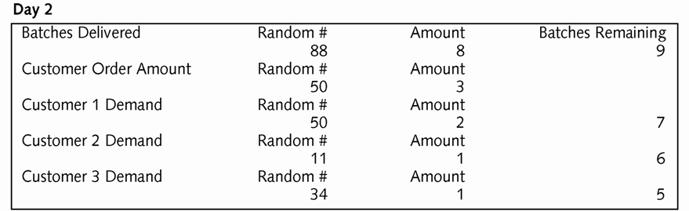
Albert’s Bagel Shop Simulation

Slide 30
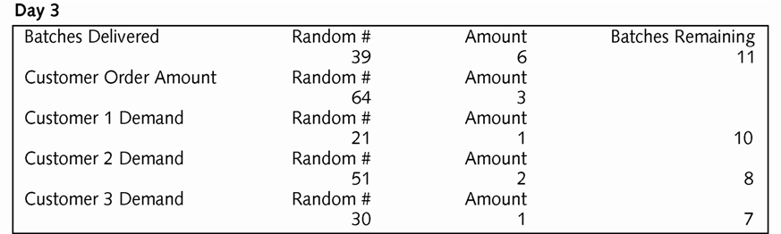
Albert’s Bagel Shop Simulation

Slide 31
Process Flow Map for City Opera Call-in Center
Work Station
Agent 1
Buffer
Call Queue
Buffer
Completed Calls
Entrance
Call
Work Station
Agent 2

Slide 32
Process Flow Map for City Opera Call-in Center with Automation
Work Station
Contact Agent 1
Buffer
Call Queue
Work Station
Contact Agent 2
60%
Switch
Buffer
Completed Calls
Entrance
Call arrives
40%
Work Station
Machine
Buffer
Auto
Queue

Slide 33
SimQuick Electronic Files:
The publishers of SimQuick would not allow us to reproduce electronic images of their files for the purposes of an instructor’s CD.

Slide 34
Chapter Summary
Process analysis is the starting point for process improvement
Process flow charts enable communication, focus attention on the customer, and identifies areas for improvement
Simulation is a tool to help understand current processes and evaluate the impact of possible improvements

